Slide 1
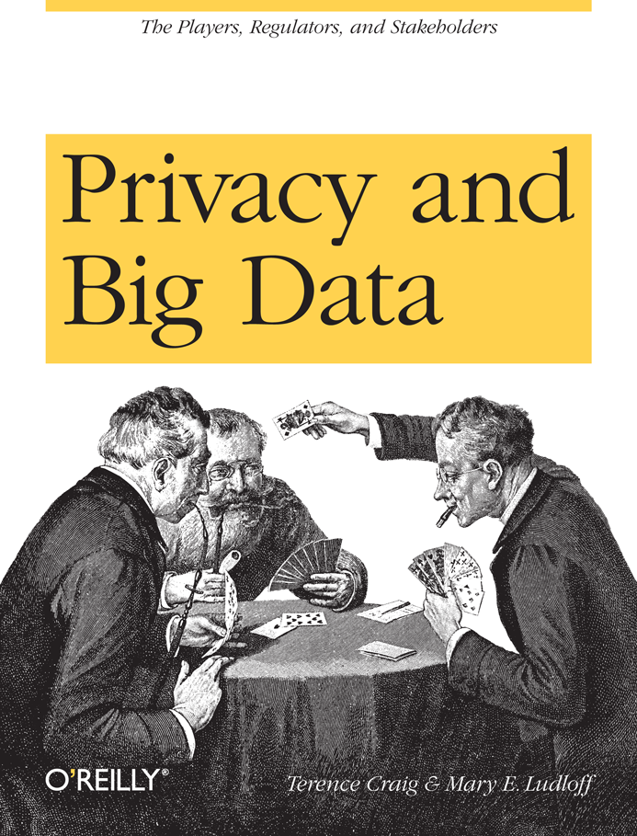

How Much Privacy Can We Really Expect?
By:
Terence Craig, CEO, PatternBuilders
Mary Ludloff, VP, Marketing, PatternBuilders
Notes:
Since PatternBuilders is a big data analytics company we had a bird’s eye view on how big data tech has had a profound impact on our expectation of privacy. We wrote the book to give those not in the big data world an idea about what was happening with privacy from many different viewpoints: culture, the various regulatory environments, and the many players who have large monetary stakes in how the ongoing privacy debate plays out.

Slide 2

Before I Begin: A Disclaimer
While I believe that privacy, as we used to know it, is dead, a funny thing happened as I worked on this session… There were some pieces of information I was not comfortable with. Go figure!

Slide 3

Welcome to the Digital World!
Where everybody knows your name (your friend’s name, your likes and dislikes, where you shop, what you buy, where you travel, fill-in-the-blank)….

Slide 4
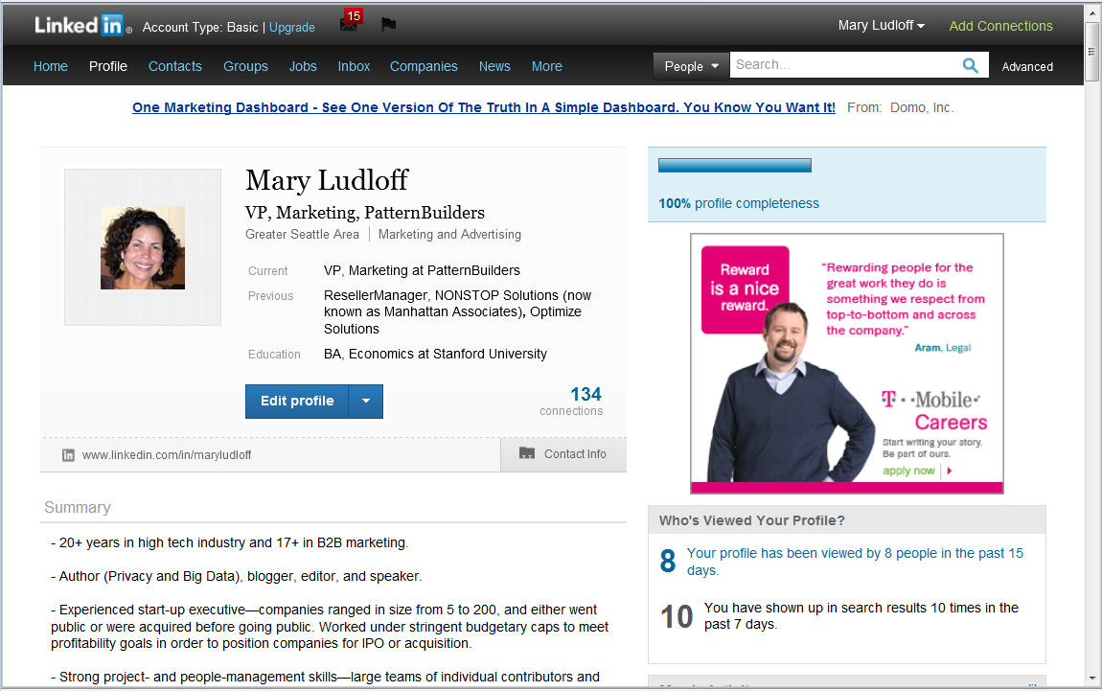
It’s So Nice to Meet You …
You may know me from LinkedIn…
Oh and I might be watching you watch me….

Slide 5
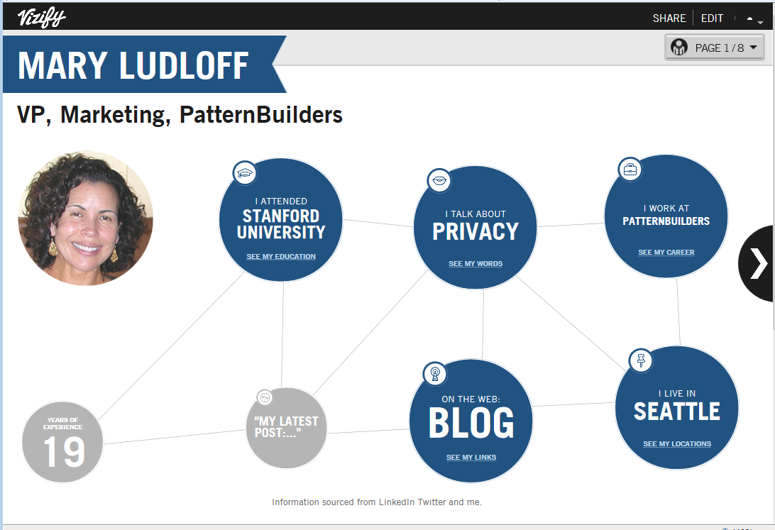
Here’s My Profile on Vizify

Slide 6
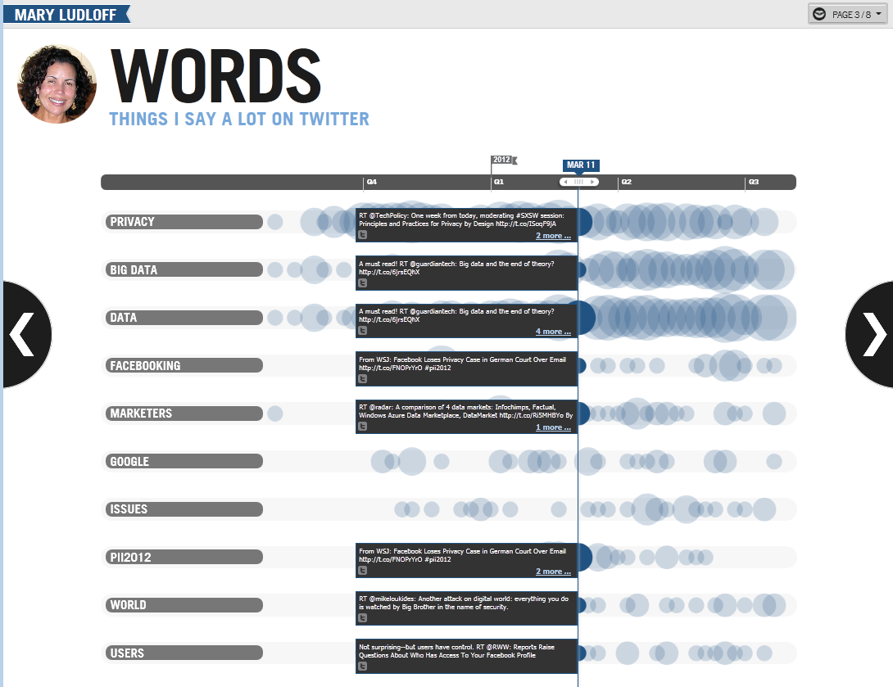
Here’s What I Talk About On Twitter

Slide 7
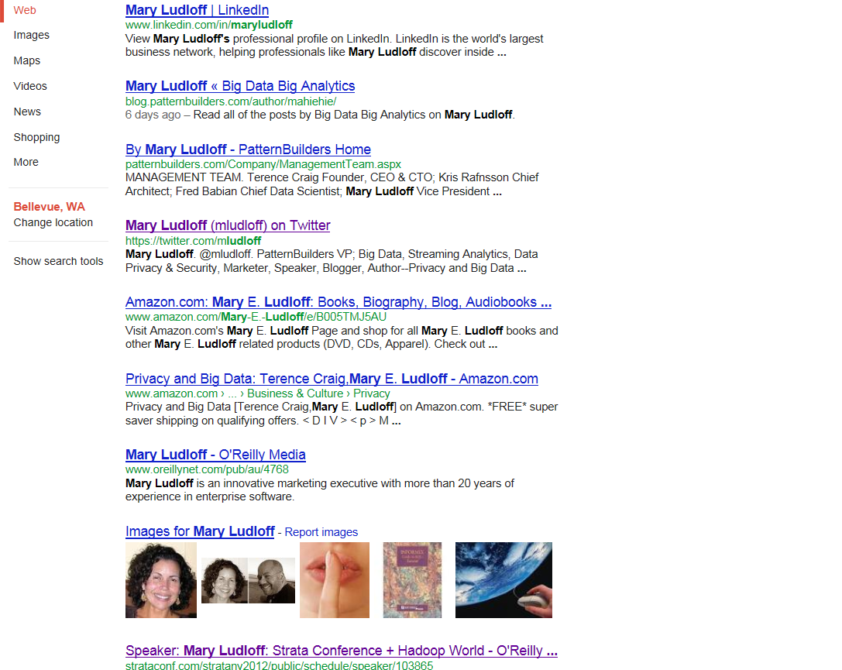
If You Google Me, This Is Probably What You’ll See
Not many images of me—that’s because I encourage family and friends NOT to upload photos of me and insist on no tagging when they do. Oh, and I don’t have a Facebook page—I’m a luddite!

Slide 8
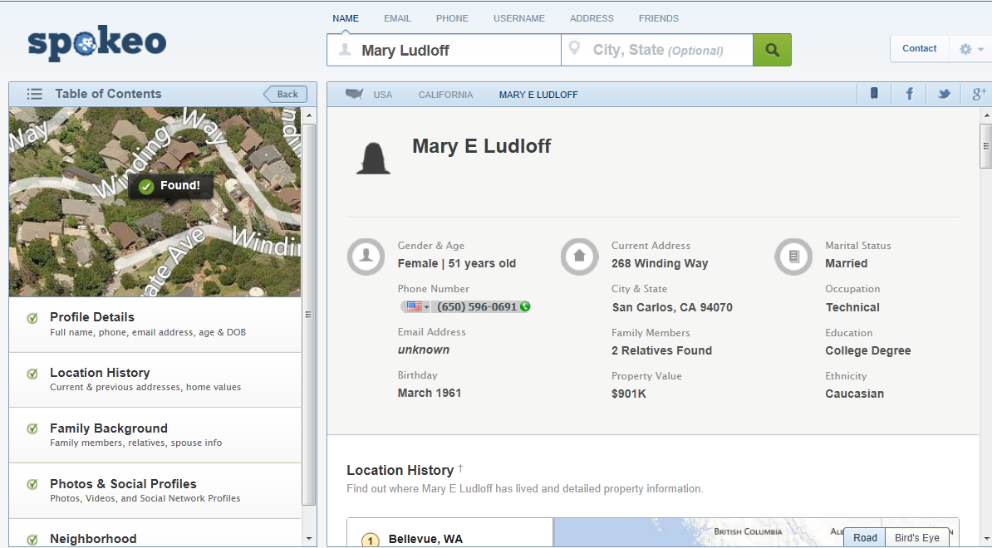
Here’s What Spokeo Has to Say About Me
Full disclosure: This is not my current address, but gender, age, and birthday are all correct.

Slide 9
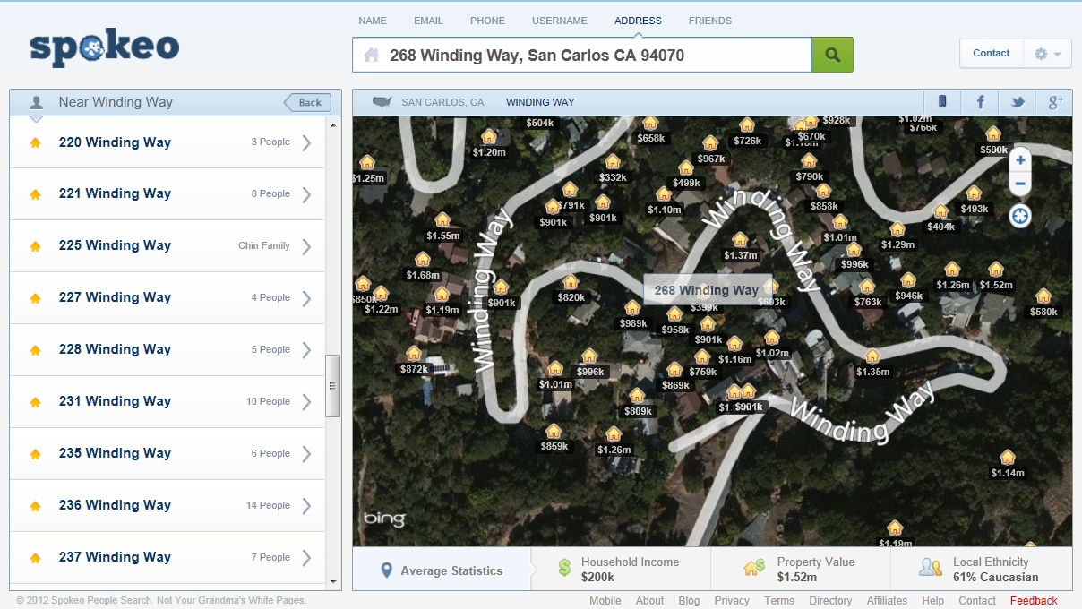
Oh & Here are Some Demographics on My Neighborhood
And if you wanted, you could drill down on these addresses and pull up “similar” information on anyone in the neighborhood.

Slide 10
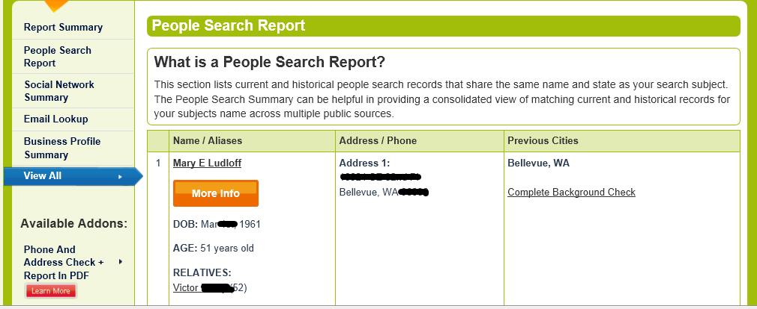
Here’s What Intelius Had to Say
There’s other stuff to see here, but note the redactions (done by me). And keep in mind this is all publicly available information.

Slide 11
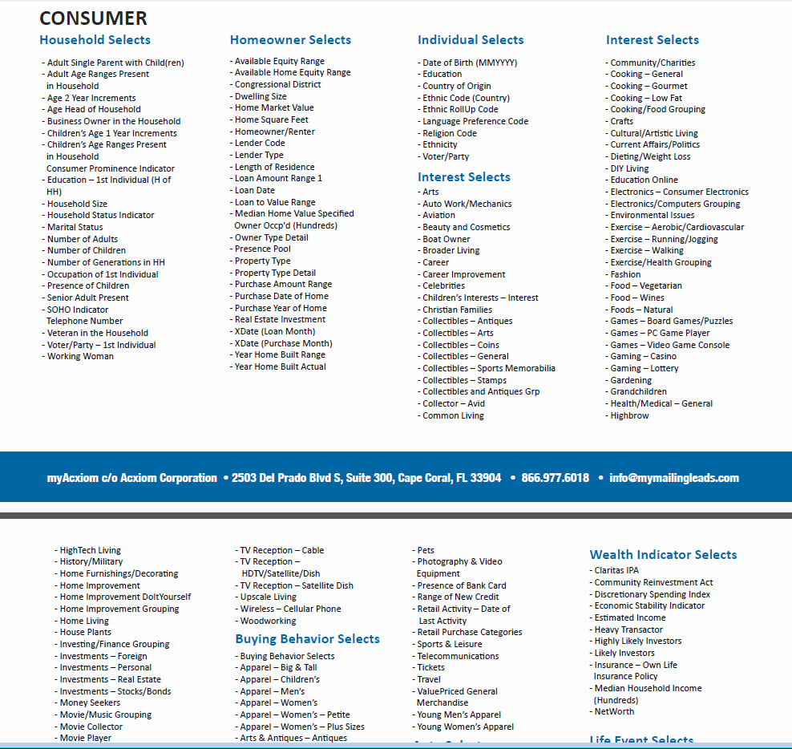
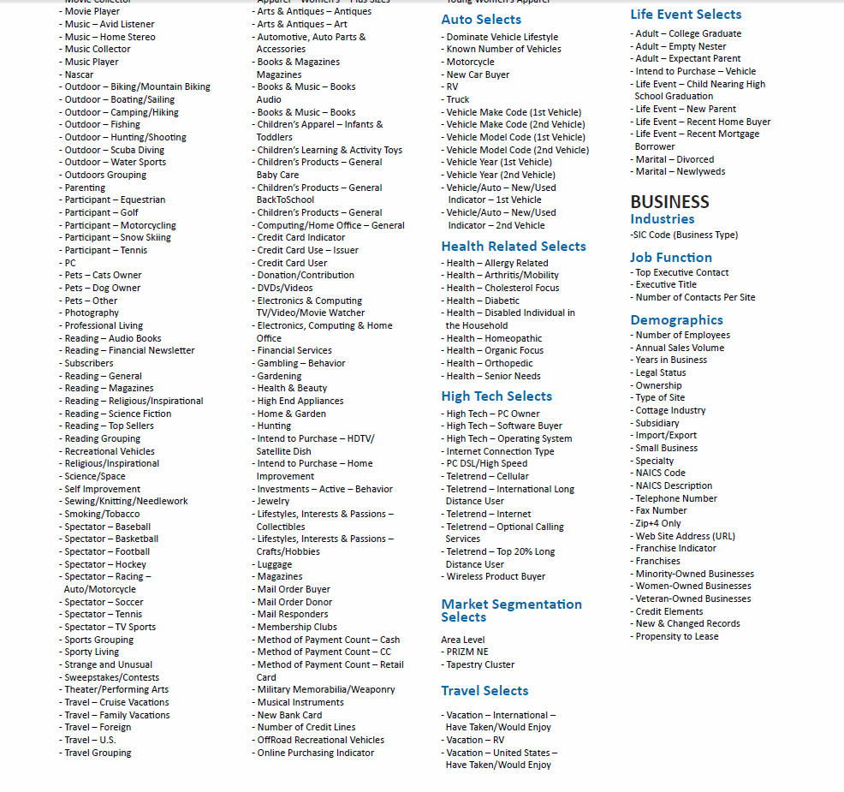
Here’s Some of What Acxiom Knows About 190 Million of Us

Slide 12
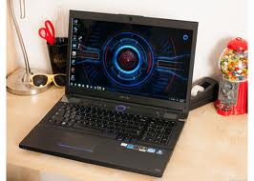

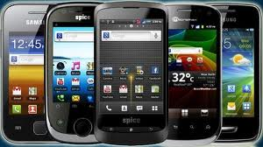

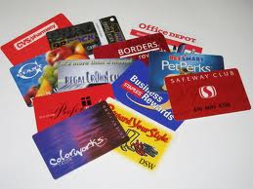
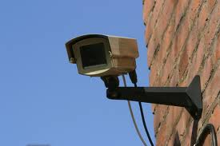
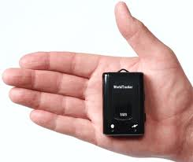
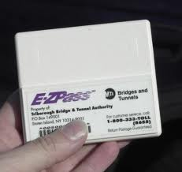

Online or Offline, We Are All Being Tracked

Slide 13
Data Collectors are On the Rise
There are the “giants” like Google, Facebook, and Twitter…
There are organizations and agencies like the Florida DMV…
There are “Mom & Pop” operations that specialize…
Our personal information is a commodity that supports thriving business models—from tens of billions down to hundreds and thousands of dollars.

Slide 14

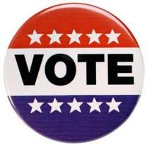



And Its Uses Are Infinite
Target knows when we’re pregnant.
But is careful about it to prevent “creepiness factor.”
Political campaigns are mining our information.
Buying “information” from Acxiom, Experian, & Equifax.
Asking supporters for access to their Facebook accounts & other social networks—who are your friends and how can we influence them?
Federal police can access our accounts in real-time.
No warrants required.
Welcome to targeted advertising.
Same goes for our email and cell phones.

Slide 15
Three things we know for sure.

Slide 16
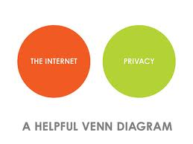


1. If you want it kept private, keep it off the ‘Net and your devices.

Slide 17


2. At some point in your life, you will be the victim of a data security or privacy breach—most likely multiple times.

Slide 18
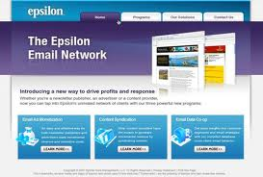










3. At some point in your company’s life, they will experience a data security or privacy breach—most likely multiple times.

Slide 19
Our Advice to Consumers
Be mindful of what information you share and who you “choose” to share it with.
Read data collection, usage, and retention policies. If you don’t like the policy don’t share.
Regularly Google and Spokeo yourself to see what information is currently out there about you.
Use privacy resources to monitor and manage exposure.

Slide 20
Our Advice to Business Players—The 4 B’s
Know your regulatory environment:
U.S.: more than 30 federal statutes, 100 state regulations for data security and privacy.
Engage with a law firm that specializes in privacy, security, technology and IP.
Share with your customers/consumers:
Share what data you collect, how you use it, and whether you sell it to third parties.
Breaches are inevitable:
When things go wrong know how you are going to deal with them.
Trust is key:
EU and other countries: far more restrictive so think global.
Pending legislation in all regions with more rigorous controls.
Be explicit about data retention.
Be explicit about what you can protect and what you cannot (anti-terrorism laws).
Get a team and process in place and be ready to respond.
Remember, consumers don’t’ have to “play” with you—but if you treat them well, you create stickiness.
It may be your business model but look at data collection and usage from your customers’ point of view—don’t’ be creepy.

Slide 21
This is the World We Now Live In
"We're able to analyze what people are viewing on their handsets. If you're at an MLB game, we can tell if you're viewing ESPN, we can tell if you're viewing MLB, we can tell what social networking sites you're activating, if you're sending out mobile usage content that's user-generated on video… We're able to identify what that customer likes not by filling out a form, but by analyzing what they do on a day-to-day basis. We're able to serve them products that we know they like because we've seen that they've gone through and downloaded products like it. “
-Bill Diggins, U.S. Chief, Verizon Wireless Marketing Initiative xx

Slide 22
Questions—I Might Have Some Answers!
Contact Us | Terence: terence@patternbuilders.com, @terencecraig Mary: mary@patternbuilders.com, @mludloff
Blog | blog.patternbuilders.com
Corporate Site | www.patternbuilders.com
Privacy & Big Data Resource Page | www.privacyandbigdata.com

